Slide 1
UML-Based Modeling for a Food Delivery System
CSA1102-Object Oriented Analysis And Design
Presented By
192372043 (C.Tejashwi)
192320090 (P.Praveena)

Slide 2
Introduction
A Food Delivery System is an online platform that enables customers to order food from restaurants.
It connects customers, restaurants, delivery partners, and payment services in a single system.
The system manages menu browsing, order placement, payment processing, and order tracking.
UML (Unified Modeling Language) is used to model the system's structure and behavior before development.
UML improves requirement analysis, software visualization, communication, and overall system design.

Slide 3
Problem Statement
Managing multiple customers, restaurants, delivery partners, and orders simultaneously is a complex task that requires a well-structured system.
Ensuring accurate order processing, real-time order tracking, and timely food delivery is essential for customer satisfaction.
Secure payment processing and maintaining transaction records are critical for reliable system operation.
Without proper system modeling, misunderstandings in requirements can lead to design errors, increased development time, and higher costs.
UML-based modeling provides a clear representation of system requirements, improves communication among stakeholders, and supports the development of a reliable and efficient Food Delivery System.

Slide 4
Methodology / Approach
Requirement Analysis: Identify the functional and non-functional requirements of the Food Delivery System, including user needs and system constraints.
Actor Identification: Determine the main actors such as Customer, Restaurant, Delivery Partner, Admin, and Payment Gateway, along with their roles.
UML Diagram Design: Create Use Case, Class, and Sequence Diagrams to represent system functionality, structure, and interactions.
System Validation: Review the UML models to ensure they accurately represent the required business processes and system behavior.
Analysis and Documentation: Analyze the designed models to improve requirement analysis, software visualization, stakeholder communication, and overall software quality.

Slide 5
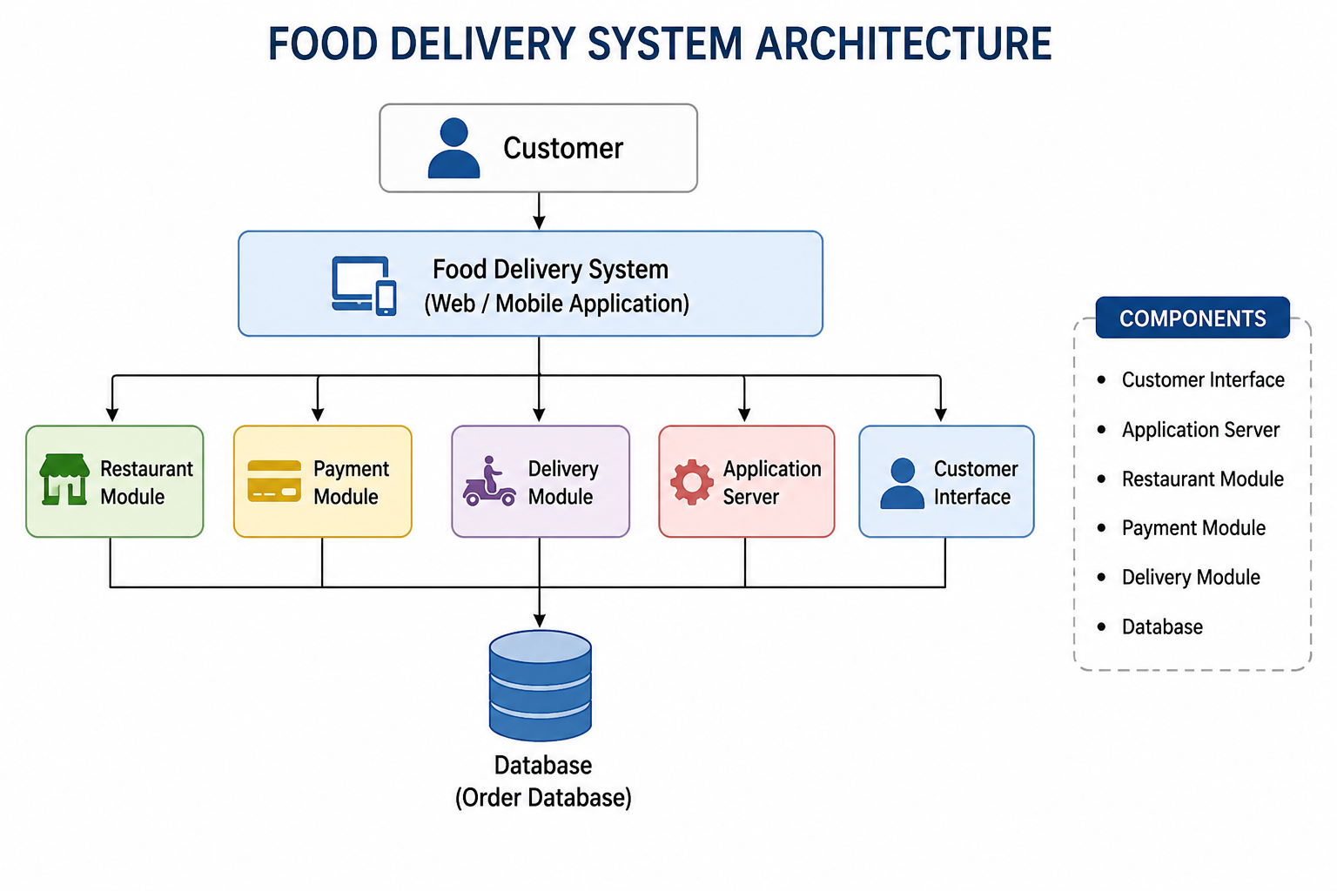
System Architecture

Slide 6
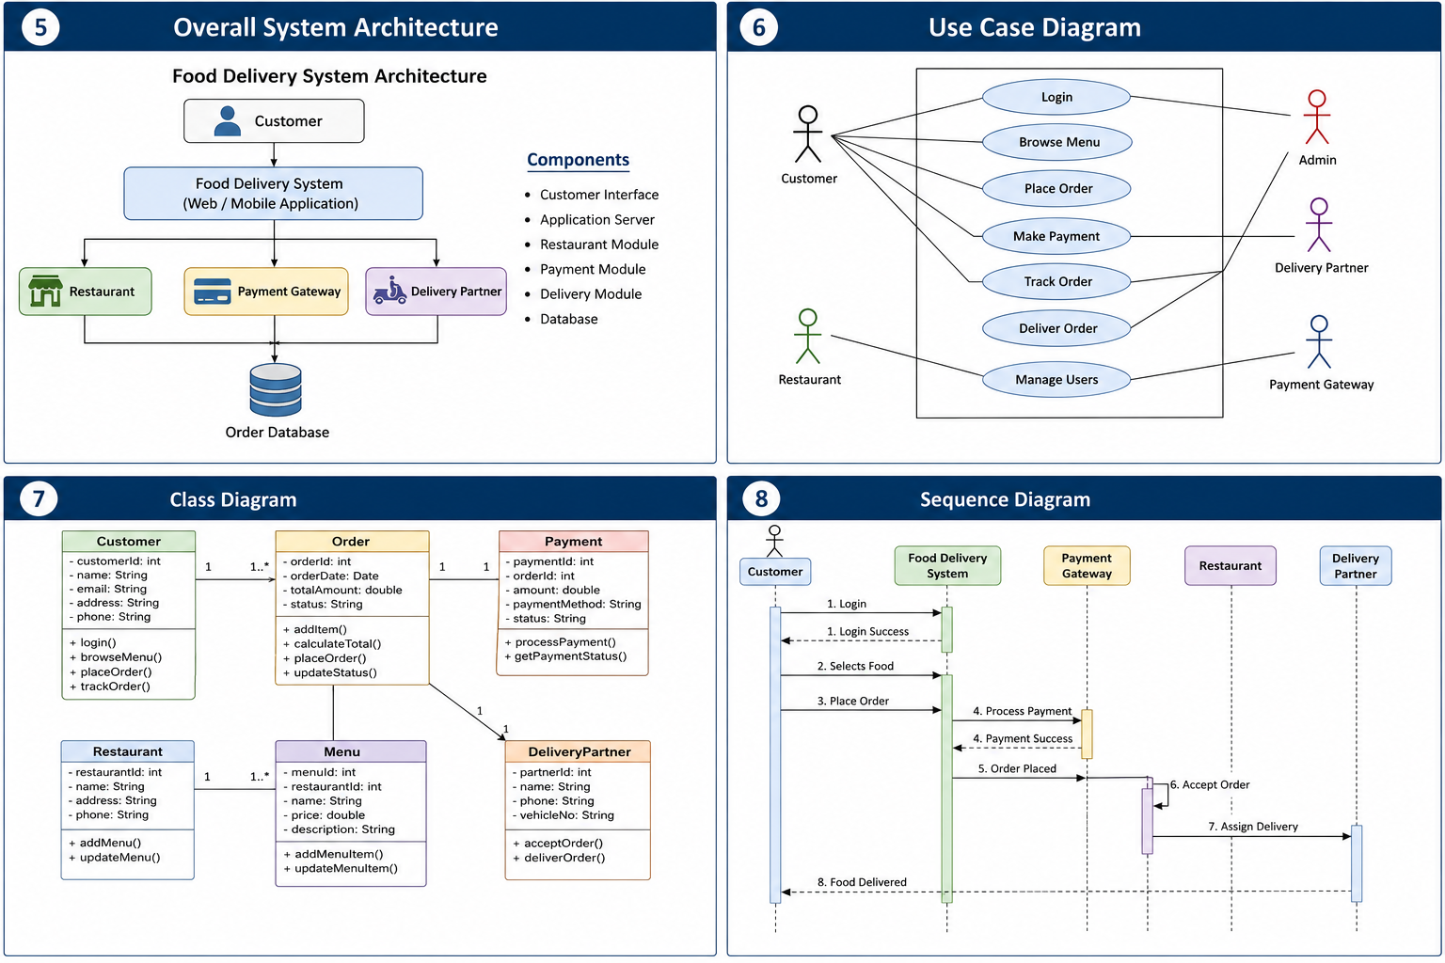
UML Use Case Diagram
The Use Case Diagram illustrates the interactions between users (actors) and the Food Delivery System, showing the system's functional requirements.

Slide 7
UML Class Diagram
The Class Diagram represents the system's static structure by showing classes, their attributes, methods, and relationships.

Slide 8
UML Sequence Diagram
The Sequence Diagram depicts the chronological flow of messages exchanged between system components during the order processing workflow.

Slide 9
Results / Findings
UML diagrams provided a clear understanding of the Food Delivery System requirements before implementation.
The system architecture and workflow became easier to visualize, reducing design complexity.
Early identification of design issues helped minimize development errors and rework.
UML improved communication and collaboration among developers, clients, and other stakeholders.
The overall modeling process contributed to the development of a reliable, maintainable, and efficient Food Delivery System.

Slide 10
Conclusion
UML-based modeling provides a clear blueprint for designing and developing a Food Delivery System.
Use Case, Class, and Sequence Diagrams effectively represent the system's functionality, structure, and workflow.
UML enhances requirement analysis by identifying system components and user interactions at an early stage.
It improves software visualization and facilitates effective communication among developers and stakeholders.
Overall, UML modeling contributes to the development of a reliable, scalable, and maintainable software system.

Slide 11
